Slide 1
Discriminant Analysis
David Mukajanga

Slide 2
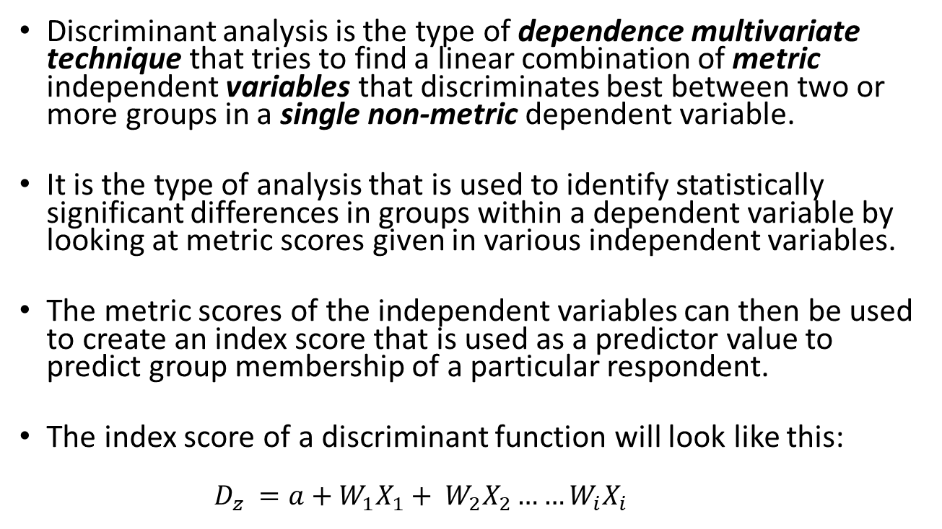
Introduction
Discriminant analysis is the type of dependence multivariate technique that tries to find a linear combination of metric independent variables that discriminates best between two or more groups in a single non-metric dependent variable.
It is the type of analysis that is used to identify statistically significant differences in groups within a dependent variable by looking at metric scores given in various independent variables.
The metric scores of the independent variables can then be used to create an index score that is used as a predictor value to predict group membership of a particular respondent.
The index score of a discriminant function will look like this:
$$D_{z} =a+{W_{1}X}_{1}+ W_{2}X_{2}……W_{i}X_{i}$$

Slide 3
Steps of A Discriminant Analysis
Reviewing the objective of the analysis.
Verifying the Statistical Assumptions necessary for this Analysis.
Consideration of the sample size.
Dividing the dataset into the estimation sample and validation sample.
Deriving the discriminant functions.
Assessing the statistical significance of derived functions
Validating the functions and checking the practical significance (Hit Ratio)

Slide 4
The Objective of The Analysis
A Discriminant Analysis can be done for the following objectives:
Looking for the statistically significant differences between group means, meaning one wants to know whether the several groups of the dependent variable are that much different when measured in-terms of the independent variables or not.
Predicting group membership based on the score of the independent variables.

Slide 5
Validating Statistical Assumptions
In discriminant analysis, the researcher should concern him/herself with making sure there is multivariate normality in independent variables and equal dispersion in covariance matrices.
Equal dispersion in covariance matrices can be assessed by using the Box’s M Test.
Multivariate normality can be ensured by making sure that there is univariate normality among independent variables.
The researcher should be careful of multicollinearity also since it reduces the discriminatory power of independent variables significantly in step-wise model estimation.

Slide 6
Sample Size Considerations
The smaller the sample size in discriminant analysis, the more the error in prediction and the larger the sample size the larger the observed significance between the observed differences in independent variables.
The researcher should thus know to find a balance between the two where the sample is large enough to predict most accurately and small enough to only show differences that are actually intrepretable and relevant.
Responses greater in quantity than the number of independent variables in each independent variable can be used in extreme cases but at least there should be 5 responses in each independent variable.
The researcher should also make sure that the difference between group sizes in the dependent variable is not unbelievably large since a big difference between group sizes means that predictions will most likely be in favor of the group with the bigger size.
The number that has been advised as an appropriate minimum group size is at least 20 responses per group, but again, the researcher has to check that even though this number is met, the differences between the groups are not unappropriately large.

Slide 7
Prep-ing the Data for the Analysis
If the objective of the analysis is to predict group membership, a part of the overall sample should be set aside to test for the overall accuracy of the derived discriminant functions.
This can be a 50/50 split of the original dataset, 60/40, or 70/30 according to sample size. Lower sample sizes call for a higher number in the estimation sample than in the validation sample, so again the researcher is advised to be well prepared with the sample size beforehand.
The researcher should also make the split in proportion to the group sizes in the dependant variable so that each group gets fair representation in the analysis. Accredited sources on the topic have suggested stratified sampling as the best method of dividing the dataset in discriminant analysis.
Standardization can also be done in the case where the measurements units in independent variables are different.

Slide 8
Model Estimation
There are two methods a researcher can follow in creating a discriminant fuction; they are:
Simultaneous Method: Where he/she includes all the independent variables at the same time without looking at which one discriminates well.
Step-Wise Method: Where the researcher checks the discriminatory power of each variable and then adds one variable after another to the overall discriminant function based on their discriminatory power.
Selection between one and two depends on desires of the researchers in-terms of power and parsimony. The second method is better though, in-terms of power.

Slide 9
Assessing The Statistical Significance of Derived Functions
The goal here is to check whether the discriminant function obtained produces the variate index scores that are significantly different between groups.
If the researcher used the simultaneous approach in model estimation, the methods most appropriate for significance testing are Wilk’s Lambda, Pillai’s Criterion and Hotelling’s Trace.
If simultaneous model estimation has been used, the researcher has to use Mahalanobis D2 and/or Roy’s V.
After testing the significance among groups, the researcher should test individual discriminatory functions to check whether they are statistically significant or not. The model can then be re*3stimated by removing discriminant functions that are not statistically significant.

Slide 10
Assessing the Overall Model Fit
Here, the researcher will ;
Calculate thediscriminant Z score for each respondent.
Evaluate the group differences based on the Z scores.
Assess group membership accuracy.
In the first step, the researcher starts to grade respondents based on the index value given by the discriminant function.
Then he/she checks groups’ differences based on the mean value of the discriminant scores in each group.
Then he/she uses the validation sample to test the hit ratio, the percentage of responses correctly classified.
The third step is very important because although the researcher might’ve tested the statistical significance of the discriminant functions, calculating the hit ratio enables the researcher to know the practical significance of the functions, that is, how useful they are.

Slide 11
Sample Size Considerations During Testing
It is important for the researcher to understand the representativeness of the sample to the target population before going any further from here since this will guide him/her on the percentage of responses from each group will be used for the calculation of a cutting score.
If a researcher is convinced that the sample is representative, then all responses in the holdout sample will be used in the calculation of the cutting score, in respect to the relative group sizes.
If the researcher is in-deed not sure that the sample is representative, a prior probability score will be used to select the group sizes to use in the calculation of the cutting score, based on a researcher’s estimation of how much is the sample representative of the whole population.

Slide 12
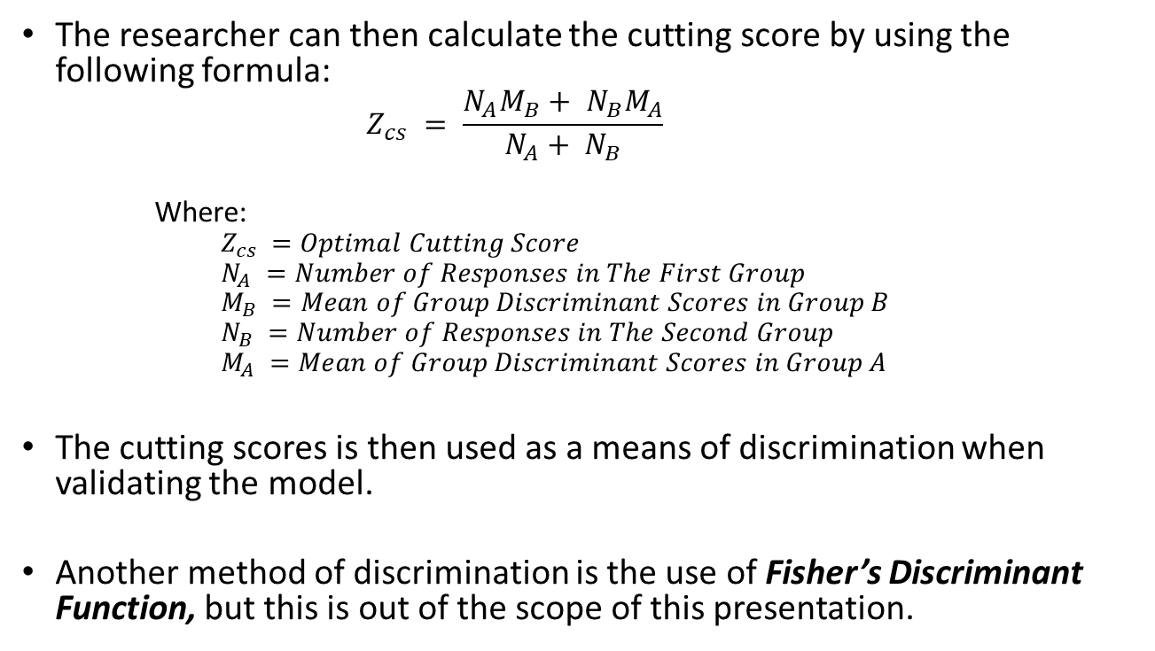
Calculating the Cutting Score
The researcher can then calculate the cutting score by using the following formula:
$$Z_{cs} = \frac{N_{A}M_{B}+ N_{B}M_{A}}{N_{A}+ N_{B}}$$
Where:
$$Z_{cs} =Optimal Cutting Score$$
$$N_{A} =Number of Responses in The First Group$$
$$M_{B} =Mean of Group Discriminant Scores in Group B$$
$$N_{B} =Number of Responses in The Second Group$$
$$M_{A} =Mean of Group Discriminant Scores in Group A$$
The cutting scores is then used as a means of discrimination when validating the model.
Another method of discrimination is the use of Fisher’s Discriminant Function, but this is out of the scope of this presentation.

Slide 13
Validation and Calculating the Hit Ratio
After getting the optimal cutting score, the researcher can begin to check how many responses were classified correctly and not, by checking whether their individual discriminant score exceeds the optimum cutting point or not.
The result of this procedure is the creation of the classification matrix. This matrix shows the amount as well as the percentage of all responses in the validation sample that were correctly and incorrectly classified.

